Slide 1

Introduction to
A standard vocabulary for economic networks
for FabCityOS
Adam Burns adam@dyne.org 2021-10-06 v1.0

Slide 2
What is Valueflows?
Valueflows is a set of common vocabularies to describe flows of economic resources within distributed economic ecosystems
Valueflows is based on a REA Economic Model
REA stands for Resources, Events, & Agents.
Agents are individual persons or organizations who perform Economic Events
affecting Economic Resources.
An Economic Event take actions on Economic Resources such as create, change, consume, use, or destroy - or transfer them from one Agent to another, or
transport them from one place to another.
Economic Resources can include: Digital Designs ● Physical Products & Parts ● Money, or tokens ● Energy ●Labor power & specialised skills

Slide 3
ValueFlow Ontology Levels
Knowledge
(now)
Plan
(future)
Observation
(past)

Slide 4
ValueFlow Ontology Levels
Knowledge
Resource
Specification
Recipe
Process
Specification
Plan
Intent /
Commitment
Process
Observation
Economic
Resource
Economic
Event
Agent

Slide 5
Value Flows – tracking forward, tracing back
Resource
Input Event
Material
or
Design
Passport
Process
Output Event
Resource
Input Event
Material
or
Design
Passport
Process
Output Event
Resource
Resource
Input Event
Material
or
Design
Passport
Material
or
Design
Passport
Process
Output Event
Resource
Input Event
Material
or
Design
Passport
Resource
Input Event
Material
or
Design
Passport
Product
Tracking forward
Collaboration
Income
Tracing backward
Reputation

Slide 6
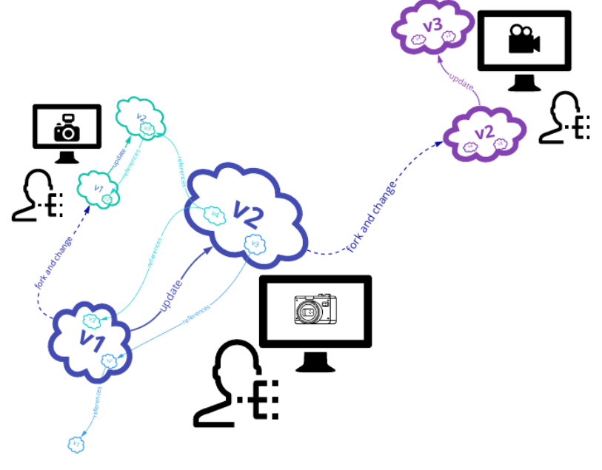
Example Design Flow
Design a Camera Body

Slide 7
Example Design Flow – Camera Body Design
Knowledge
Design
Component
Specification
CAD
Application
Specification
Design
Repository
Specification
Camera
Body Design
Specification
Plan
Observation
Key
Resource
Event
Process
Agreement

Slide 8
Example Design Flow – Camera Body Design
Knowledge
Design
Component
Specification
CAD
Application
Specification
Design
Repository
Specification
Camera
Body Design
Specification
Plan
work 14 days
designing
cite
utilised design
components
Make camera
body design
produce 1
camera body
design
1 camera
body design
use
CAD software
for 14 days
modify
design
repository
Observation
Key
Resource
Event
Process
Agreement

Slide 9
Example Design Flow – Camera Body Design
Knowledge
Design
Component
Specification
CAD
Application
Specification
Design
Repository
Specification
Camera
Body Design
Specification
Plan
work 14 days
designing
cite
utilised design
components
Make camera
body design
produce 1
camera body
design
1 camera
body design
use
CAD software
for 14 days
modify
design
repository
Observation
work 7 days
designing
Utilised
Design
Components
cite
utilised design
components
Make camera
body design
produce 1
camera body
design
1 camera
body design
CAD
Application
use
CAD software
for 7 days
Design
Repository
modify
design
repository
Key
Resource
Event
Process
Agreement

Slide 10
Value Flows – Camera Body Design: tracking forward, tracing back
work 7 days
designing
Utilised
Design
Components
cite
utilised design
components
Make camera
body design
produce 1
camera body
design
1 camera
body design
CAD
Application
use
CAD software
for 7 days
Design
Passport
Design
Repository
modify
design
repository
Product
Tracking forward
Collaboration
Income
Tracing backward
Reputation

Slide 11
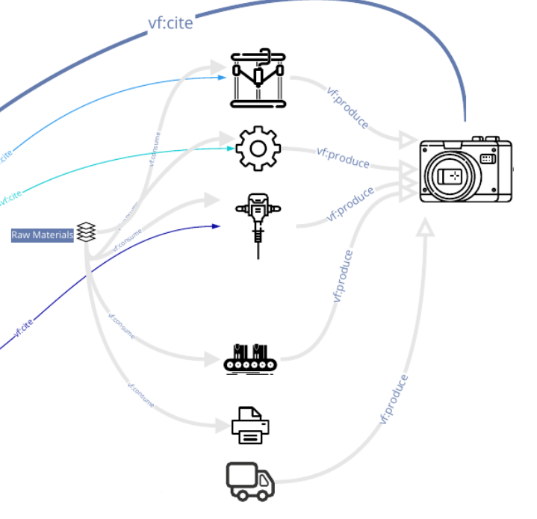
Example Manufacturing Flow
Produce a Camera Body

Slide 12
Example Manufacture Flow – Make Camera Body
Knowledge
Camera
Body
Specification
Make
Camera Body
Recipe
Metal
Specification
CNC machine
Specification
Make
Camera Body
Specification
Plan
Observation
Key
Resource
Event
Process
Agreement

Slide 13
Example Manufacture Flow – Make Camera Body
Knowledge
Camera
Body
Specification
Make
Camera Body
Recipe
Metal
Specification
CNC machine
Specification
Make
Camera Body
Specification
Plan
work 7 hours
machining
cite
camera body
design
Make camera
body
produce 1
camera body
consume 5kg
metal block
use CNC
machine for
3.5 hours
Observation
Key
Resource
Event
Process
Agreement

Slide 14
Example Manufacture Flow – Make Camera Body
Knowledge
Camera
Body
Specification
Make
Camera Body
Recipe
Metal
Specification
CNC machine
Specification
Make
Camera Body
Specification
Plan
work 7 hours
machining
cite
camera body
design
Make camera
body
produce 1
camera body
consume 5kg
metal block
use CNC
machine for
3.5 hours
Observation
work 7 hours
machining
Camera Body
Design
cite
camera body
design
Make camera
body
produce 1
camera body
1 camera
body
5kg Metal
Block
consume 5kg
metal block
CNC
machine
use CNC
machine for
3.5 hours
Key
Resource
Event
Process
Agreement

Slide 15
Value Flows – Make Camera Body: tracking forward, tracing back
work 7 hours
machining
Camera Body
Design
cite
camera body
design
Make camera
body
produce 1
camera body
1 camera
body
5kg Metal
Block
consume 5kg
metal block
CNC
machine
use CNC
machine for
3.5 hours
Product
Tracking forward
Collaboration
Income
Tracing backward
Reputation

Slide 16
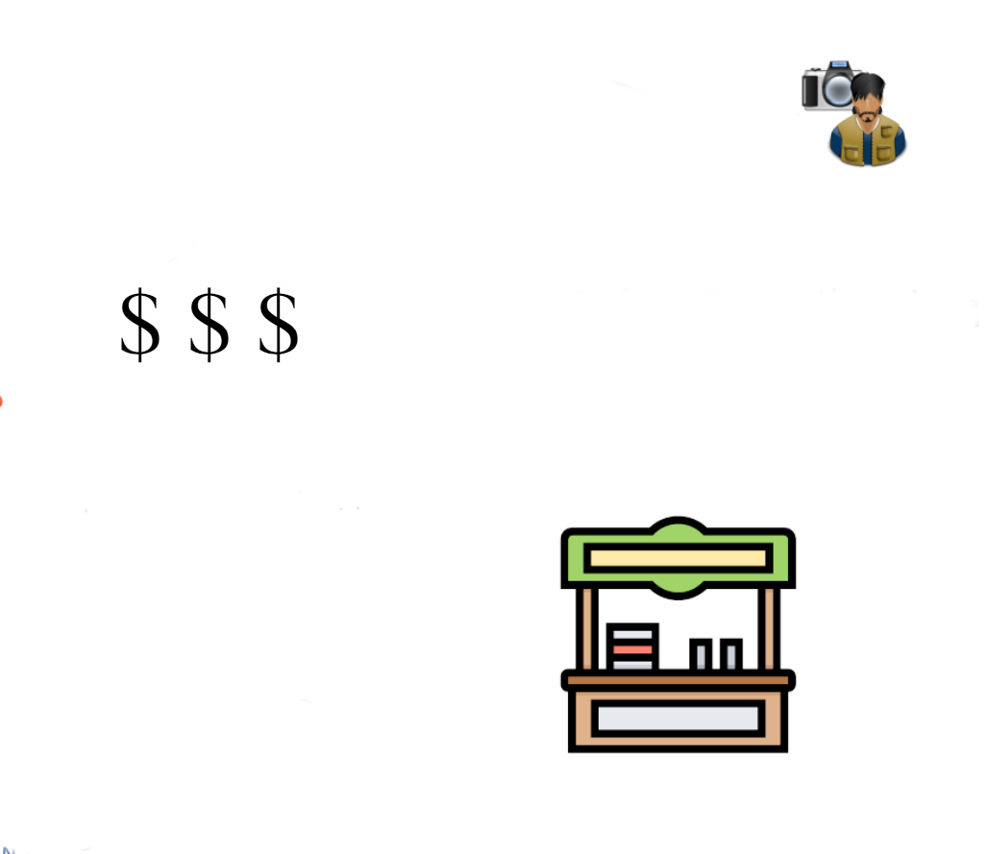
Example Sales Flow
Sell a Camera Body

Slide 17
Example Sale/Exchange Flow – Camera Body Design
Knowledge
Exchange
Recipe
Plan
Exchange
Agreement
Observation
transfer Camera
Body to Customer
Customer
Bank
Account/Wallet
Transfer
Money/Token
from Customer
Key
Resource
Event
Process
Agreement

Slide 18
Value Flows – Sales/Exchange: tracking forward, tracing back
Exchange
Agreement
transfer Camera
Body to Customer
Customer
Bank
Account/Wallet
Transfer
Money/Token
from Customer
* It is envisioned that FabCityOS Zencode smart contracts will assist in back tracing Income distribution agreements across the digital and material lifecycles.
Product
Tracking forward
Collaboration
Income
Tracing backward
Reputation

Slide 19
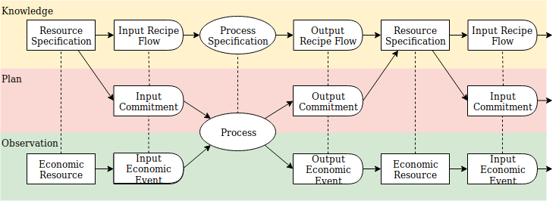
ValueFlows Levels in summary ...

Slide 20
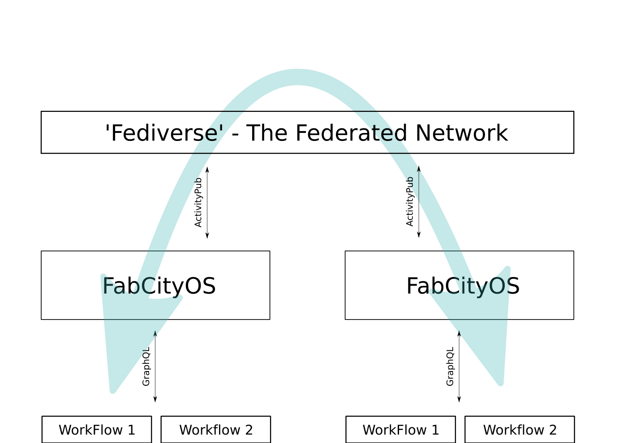
ValueFlows vocabularies flow across the FabCityOS network

Slide 21
Thank you
For more detailed information
https://valueflo.ws
Questions / Feedback?
With Kind Thanks to Lynn Foster & Bob Haugen for assistance and permission to reuse and modify existing Valueflows presentation material

